Slide 1
Introduction

Slide 2
Where my children spend all that money ?
How much should i give money to my children ?
What are my children buying with that money ?
What is the exact pocket money my children need ?

Slide 3
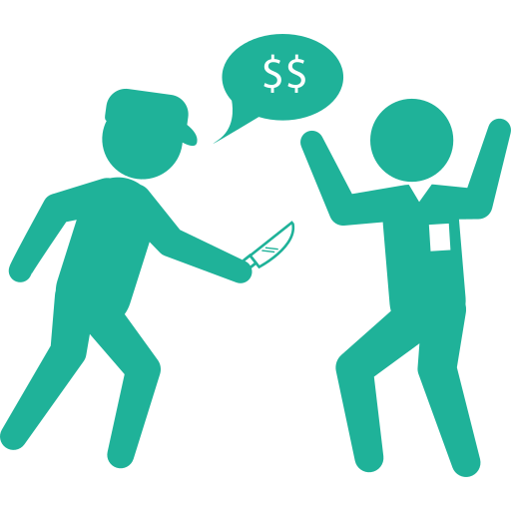
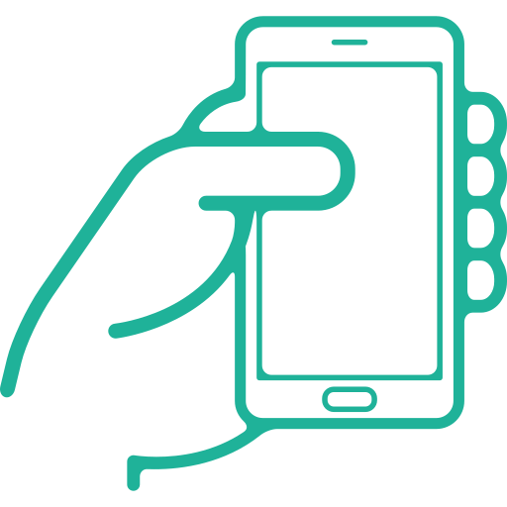
Problem
48
RobberY per day
In tunisia
Phone use per child

Slide 4

Our SOlution

Slide 5



PARENTS BENeFITS
Saving time
Tracking
Give right amount of pocket money
Notes:
siwar

Slide 6

children BENeFITS
no more cash
Management skills
Notes:
siwar

Slide 7



BANK BENeFITS
2.2
CHILDREN PER FAMILY
LOYALTY BASE
MORE DATA
Notes:
Wajih

Slide 8


Market SIZE
10%
Notes:
Logo famille

Slide 9



Competitors
SIMPLICITIES
FUNCTIONALITIES
Notes:
Wjih

Slide 10
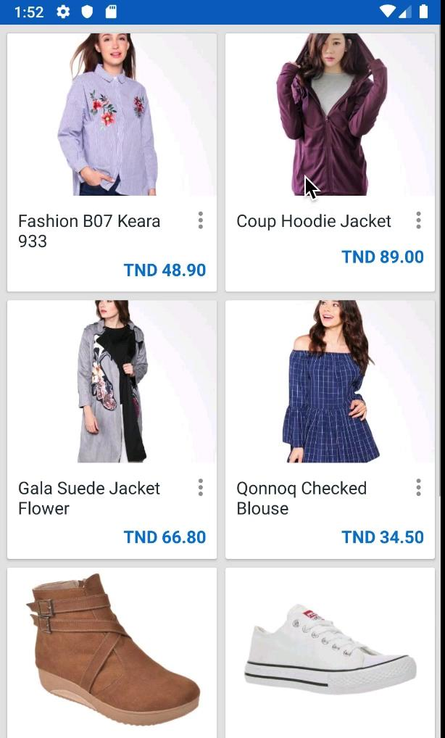
PRODUCT

Slide 11


Slide 12




“We care about family”

